Slide 1
Capstone Project-1
Mobile Price Prediction Individual Janhavi Shembade

Slide 2

Contents:-
1.Business Context/Understanding
2.Objective
3.Data Summary
4.EDA
5.Model Training
5.Target Feature
6.Model Implementation
7.Challenges
8.Conclusion

Slide 3
Business Problems Understanding:-
1.This project aims to analyze the data to determine the price range of mobile .which are having various factors in considerations like battery power,pixels,wifi, price etc.
2.So in this project various factor specification decides the mobile price ranges.and company are able to manufacture those mobiles with top competitors to get the good revenue from sale.
3. As we know mobile is the best selling and purchasing device.the purpose of this project is to estimate the best price.

Slide 4
Objective:-
1.In the competitive mobile phone markets company wants to understand the sales data of mobile phones.
2.Making it useful for customer to verify that they are paying best price for a mobile.
3.Understand about which factors may affect the price range.

Slide 5
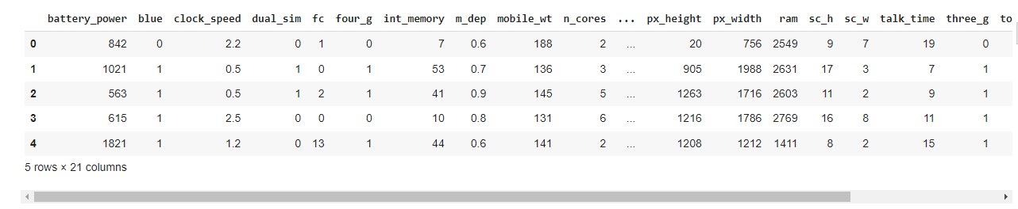
Data Summary:-
There are 2000 Rows and 21 columns are present
First 5 rows:-

Slide 6
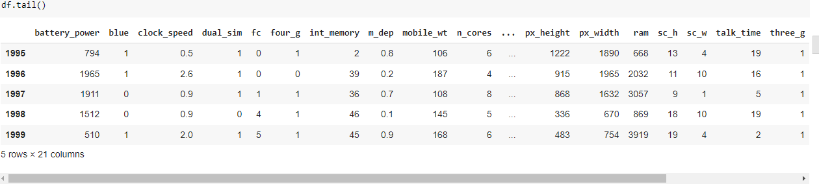
Contd..
Last Five Rows:-

Slide 7
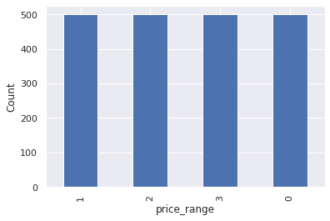
Analyzing Output/Variable (Price Range):-
Below graph shows the price range and their count.
Price Range is in 0,1,2,3

Slide 8
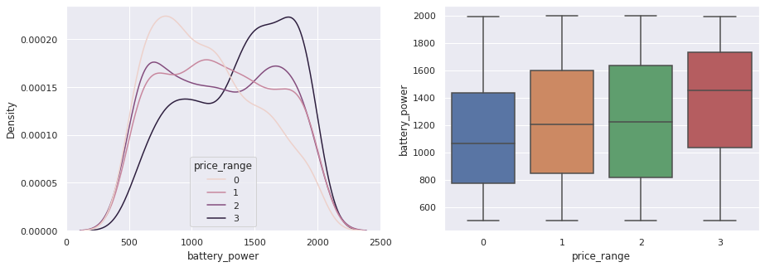
Analysis of Price Range with Battary Power

Slide 9
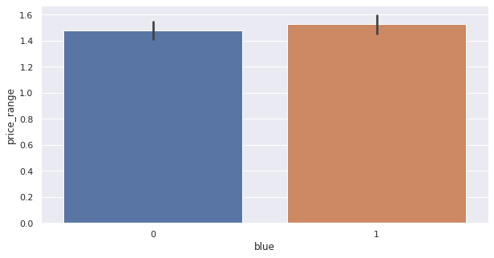
Analysis of Bluetooth vs Price
Here we can see that half of don’t have any device like bluetooth

Slide 10
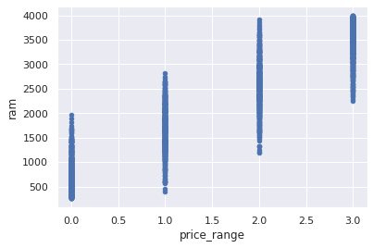
Price_Range vs RAM
Below graph show how gradually increases the price range with RAM

Slide 11
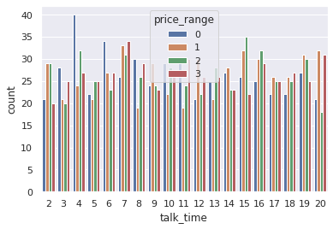
Price Range vs talktime
This is plots which shows the Talk time rate against the price.

Slide 12
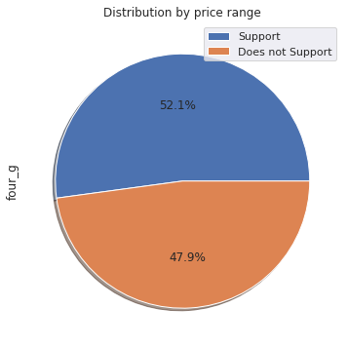
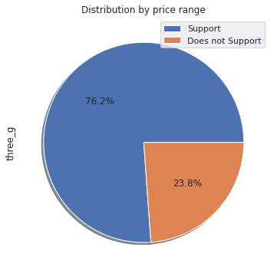
Analysis of 3G and 4G

Slide 13
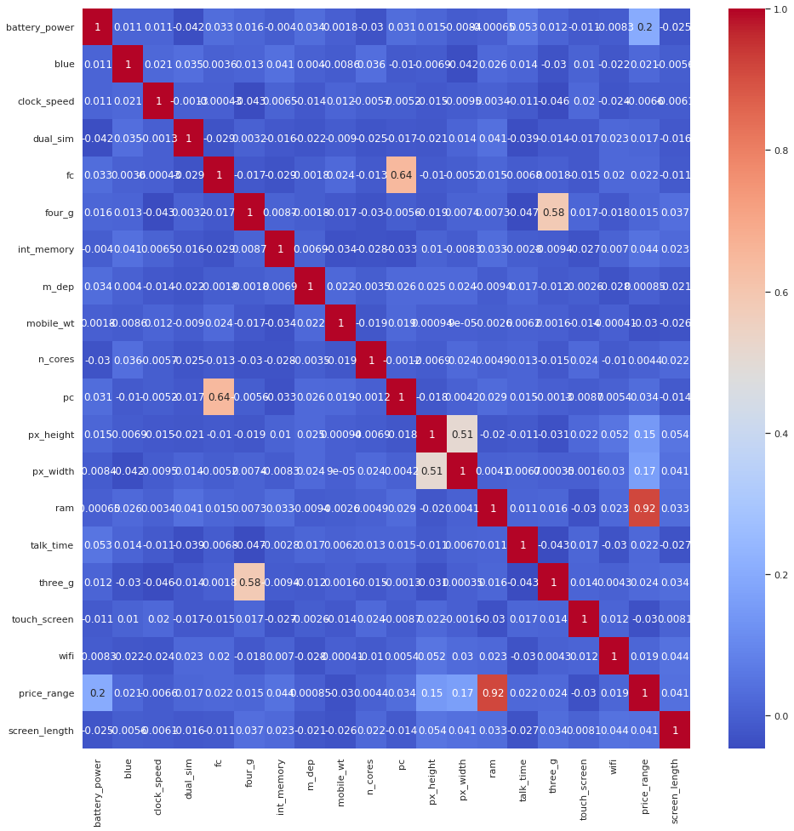
Correlation metrics graph

Slide 14
cont..
There is some collinearity in feature pairs ('pc', 'fc') and ('px_width', 'px_height'). Both correlations are justified since there are good chances that if front camera of a phone is good, the back camera would also be good.
RAM and price_range shows high correlation which is a good sign, it signifies that RAM will play major deciding factor in estimating the price range.

Slide 15
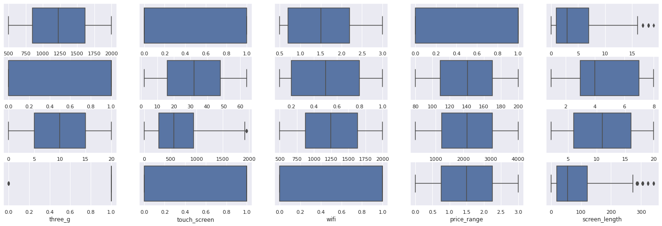
Outlier Detection in all para:

Slide 16
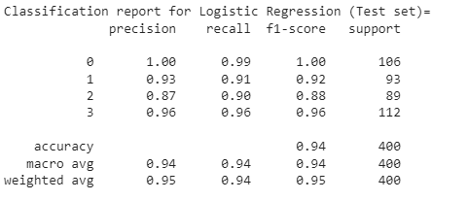
Logistic Regression:-
It is a supervised Ml algorithm is used to predict probabilities of algorithm.It having the target variable i.e discrete/catogorical ex:-True/False,yes/no,Approved/decline.
It uses linear regression model so we can say logistic regression model.
It uses logloss function i.e nothing but logloss function.

Slide 17
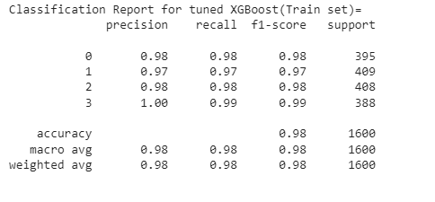
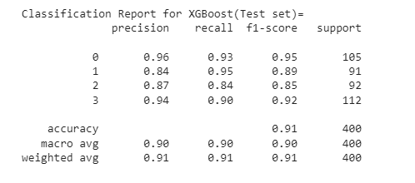
XGboost:-
Decision trees are created in seuential form
weights plays an important role in xgboost.weights are assigned to all independent variable.which are fed decision tree which predicts result.

Slide 18
Conclusion
1.Mobile phones have 4 price in ranges
2.For bluetooth half of having devices and half don’t have any devices
3.Price Range for battery power is in increasing order
4.Ram has continuous increase with price range while moving from Low cost to Very high cost.
5.costly phones are light in weight and having RAM,battery power and pixel
6.plays very significant role for deciding prices.
7.form all the above experiments we can conclude that logistic regression and,XGboosting with using hyperparameters we got the best results

